Slide 1





Predicting Major Earthquakes with Historical Data Analysis in Python
Amber Giza, Jared Graham, Irene Gwyneth Smith
TEAM C MSDS (Master’s of Data Science)
School of Technology & Computing (STC)

Slide 2
Agenda
Abstract and Introduction
Background
Literature Review
Data and Approaches
Methodology
Conclusion
Future Work
Key Reference
Q&A

Slide 3
Abstract and Introduction
Creating a predictive model to forecast potential occurrences of major earthquakes
Leverage machine learning and data visualization tools
Utilize risk assessment
Notes:
This project focuses on creating a predictive model using Python to forecast potential occurrences of major earthquakes, specifically those with magnitudes of 9.0 or higher. We will analyze historical earthquake data to identify patterns that can indicate future high-magnitude events. The goal is to leverage machine learning techniques and data visualization tools to provide actionable insights for improving earthquake preparedness and risk assessments in vulnerable areas.
Keywords: Data visualization, Python, OpenCV, Image Processing, Natural Disaster, Earthquake Detection, Pandas, Matplotlib, and Data Analysis.

Slide 4
Background
Earthquakes’ destructive power of having a magnitude of 9.0 or higher
Understand the underlying causes of earthquakes
Help mitigate a plan for a potential disaster
Notes:
Background. Earthquakes are one of the most devastating natural disasters, capable of causing widespread destruction and loss of life. Understanding the underlying causes of earthquakes and their patterns is crucial for mitigating risks and improving preparedness. This project delves into historical earthquake data, leveraging data science tools to uncover meaningful trends. By focusing on seismic events of magnitude 9.0 and higher, we aim to identify predictive factors that could signal the likelihood of such events in the future. The study’s primary goal is to empower emergency responders and city planners with data-driven insights to reduce the impact of potential disasters.

Slide 5
Literature Review
Tectonic plate movements and seismic risks.
Machine learning for seismic event prediction.
Early warning systems' success stories.

Slide 6
Data and Approaches
Dataset from Kaggle that includes:
Magnitudes
Locations
Depths
Damage Estimates
Time (as Pandas Datetime Object)
Notes:
The dataset used in this project was sourced from Kaggle, containing records of earthquakes dating back to 2150 B.C. Key attributes include event magnitudes, locations, depths, and associated damage estimates. Data preprocessing involved cleaning missing values, standardizing formats, and augmenting the dataset with additional columns for related disasters and economic impacts. The curated dataset forms the foundation for analysis and predictive modeling.

Slide 7
Methodology
Data Collection and Cleaning
EDA (Exploratory Data Analysis)
Predictive Modeling
Validation and Testing
Visualization and Interpretation
Notes:
Data Collection and Cleaning: Raw data was collected from Kaggle and cleaned to address inconsistencies, missing values, and irrelevant entries. Augmentation included creating derived features, such as time intervals between events and cumulative damage estimates.
Exploratory Data Analysis (EDA): Visualization techniques, such as time-series plots and heatmaps, were used to identify patterns in seismic activity across regions and time periods.
Predictive Modeling: Machine learning algorithms from scikit-learn were used to develop a model predicting the likelihood of a high-magnitude earthquake. Various models were tested to select the most accurate one.
Validation and Testing: The model was evaluated using cross-validation and metrics like accuracy, precision, and recall to ensure reliability.
Visualization and Interpretation: Graphs and maps created with Matplotlib helped visualize risk zones and highlight trends.

Slide 8
Results
Temporal, magnitude, and geospatial trends analyzed.
High-magnitude events linked to tectonic boundaries
and depth.

Slide 9
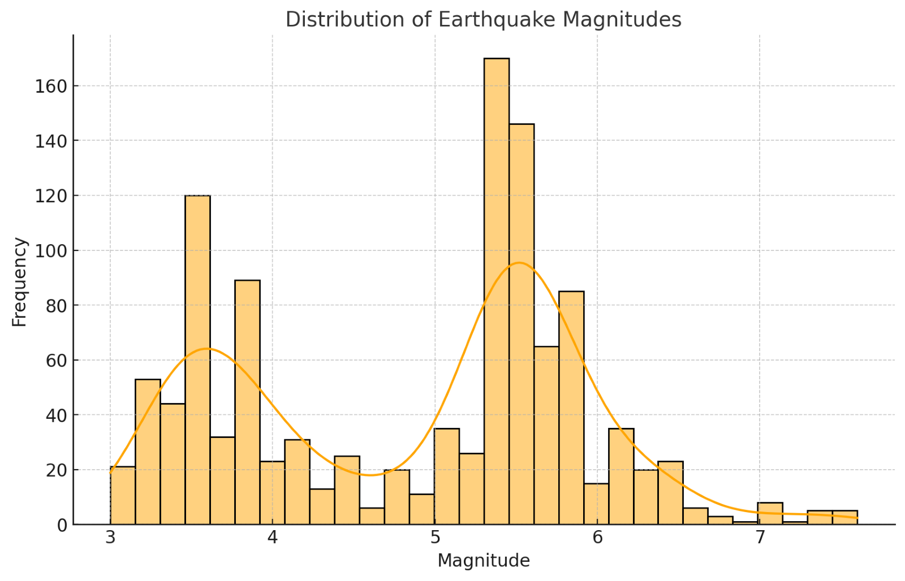
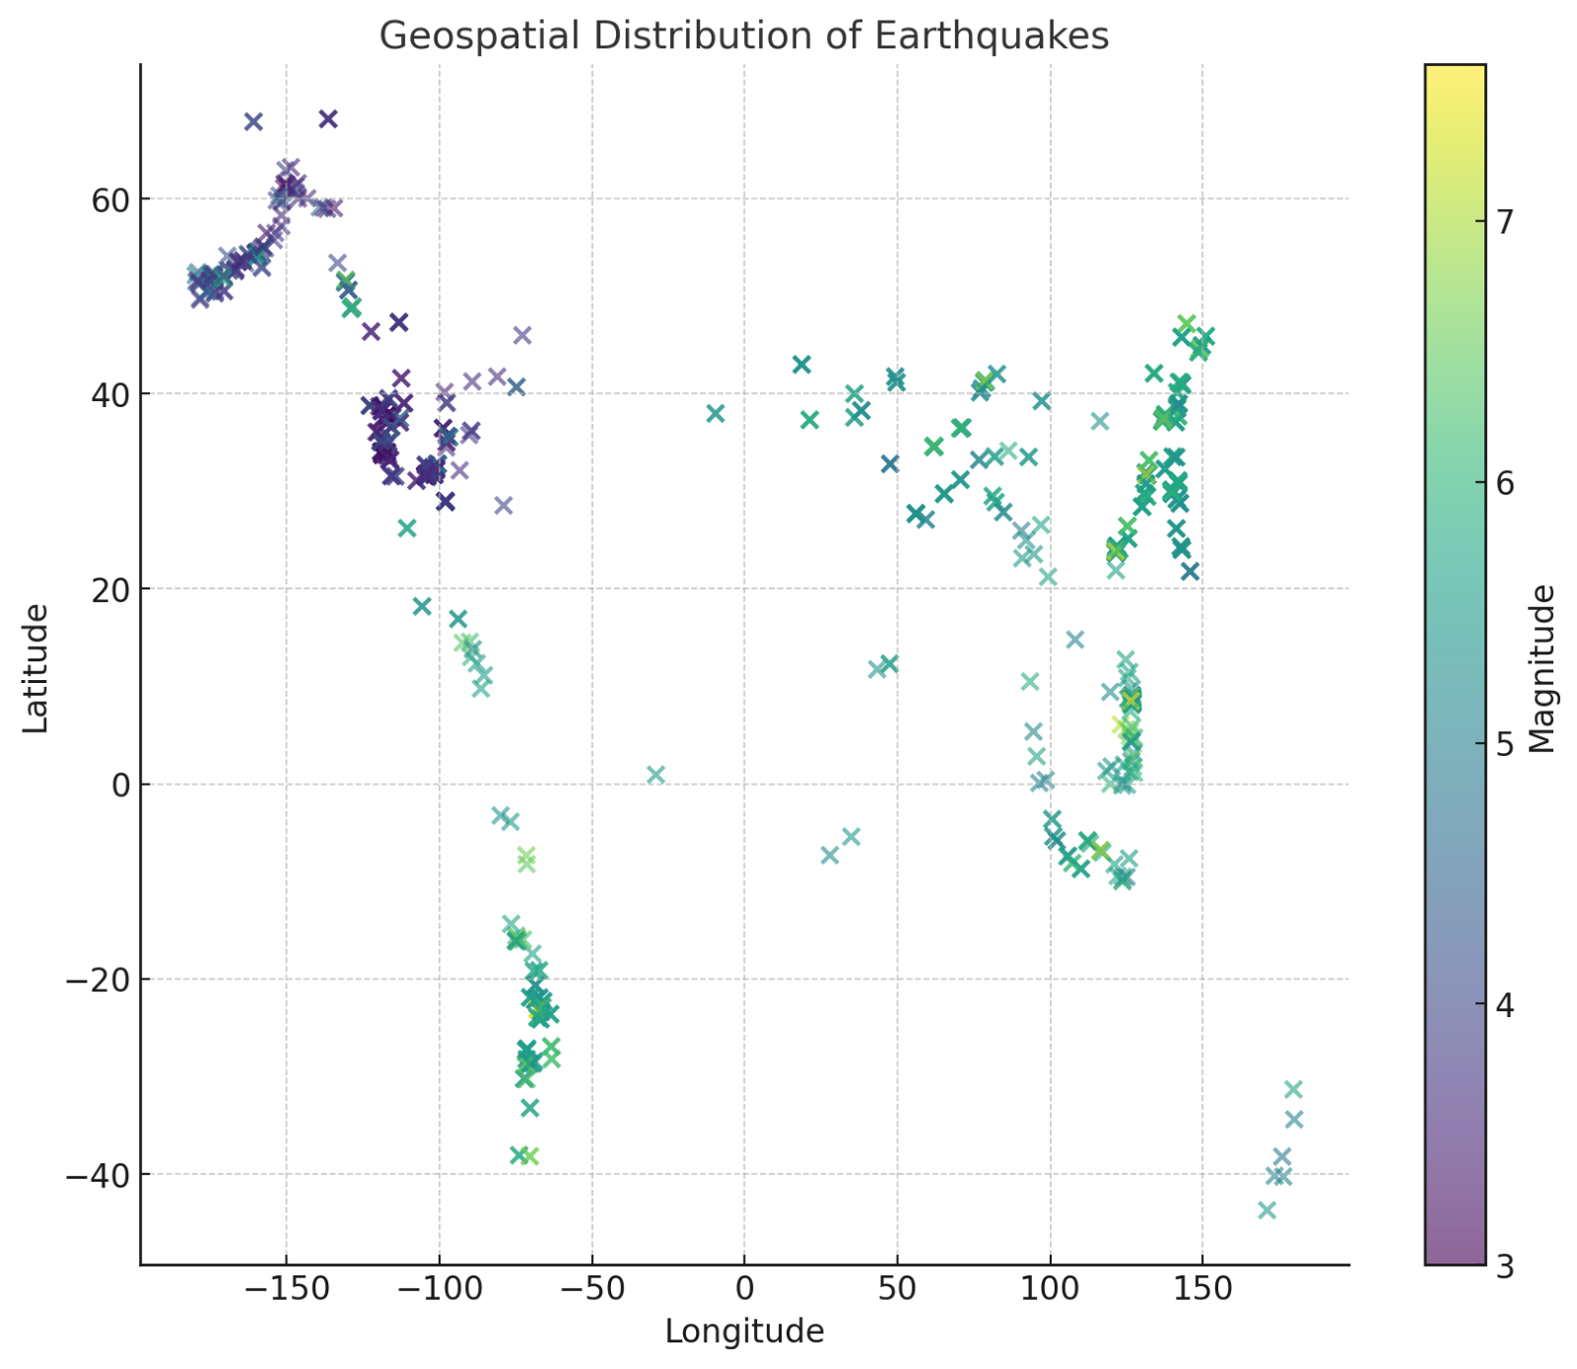
Graphs
Notes:
Distribution of earthquakes and their magnitudes
Geospatial Distribution of earthquakes that are consistent with tectonic theory

Slide 10
Conclusion
Insights for risk zones but no exact prediction capability.
Empower emergency preparedness with data-driven approaches.
Notes:
The study successfully highlights key factors contributing to the occurrence of major earthquakes. The predictive model provides a tool for identifying high-risk regions and periods, which can inform disaster preparedness initiatives. Although the model cannot predict exact times or locations, it offers valuable insights for mitigating risks and improving resource allocation. Future work may explore integrating additional geophysical datasets and testing advanced deep-learning models for enhanced accuracy.

Slide 11
Future Work
Enhance datasets with tectonic plate movement data.
Integrate advanced machine learning algorithms for higher accuracy.
Notes:
The study successfully highlights key factors contributing to the occurrence of major earthquakes. The predictive model provides a tool for identifying high-risk regions and periods, which can inform disaster preparedness initiatives. Although the model cannot predict exact times or locations, it offers valuable insights for mitigating risks and improving resource allocation. Future work may explore integrating additional geophysical datasets and testing advanced deep-learning models for enhanced accuracy.

Slide 12
Key References
Michigan Technological University "How Do We Measure Earthquake Magnitude?"
Retrieved from mtu.edu
US Geological Survey (USGS) "Can 'MegaQuakes' Really Happen?"
Retrieved from usgs.gov

Slide 13
Key References
Hammer, J. (2011) "The Great Japan Earthquake of 1923." Smithsonian Magazine.
Retrieved from smithsonianmag.com
Kaggle Dataset Historical Earthquake Data. Retrieved from Kaggle

Slide 14


Q&A

